Slide 1
COUNTNOBLANC
And
DISTINCTCOUNTNOBLANC
COUNTNOBLANC
And
DISTINCTCOUNTNOBLANC

Slide 2
COUNTNOBLANC and DISTINCTCOUNTNOBLANK
Note: This demo uses a manually entered table for testing
ID | Name | Quantity | Price
1 | ProductA | 296 | 29
2 | ProductB | 387 | 22
3 | ProductC | 331 | 24
4 | ProductD | 268 | 25
5 | ProductE | 391 | 27
6 | ProductF | 336 | 21
7 | ProductG | 308 | 21
8 | ProductH | 241 | 25
9 | ProductI | 393 | 21
10 | ProductJ | 257 | 25
11 | ProductK | 400 | 23
12 | ProductL | 362 | 28
13 | ProductM | 206 | 26
14 | ProductN | 367 | 21
15 | ProductO | 353 | 23
16 | ProductP | 336 | 29
17 | ProductQ | 389 | 30
18 | ProductR | 323 | 25
19 | Products | 354 | 29
20 | ProductT | 294 | 30

Slide 3
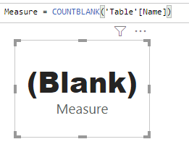
COUNTNOBLANC and DISTINCTCOUNTNOBLANK
Add Card visualization to the scene
Create a measure that counts the number of products with blank names using COUNTBLANK
Add the measure to the Values part of the Card visualization parameters
Delete two name values from the Name column to leave two blanks

Slide 4
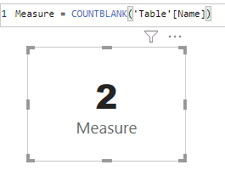
COUNTNOBLANC and DISTINCTCOUNTNOBLANK
Notice that the measurement value changes from Blank to 2
Replace COUNTBLANC function with DISTINCTCOUNTNOBLANK

Slide 5
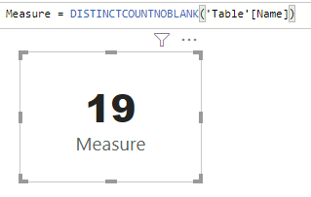
COUNTNOBLANC and DISTINCTCOUNTNOBLANK
Note that there are 19 entries that match non-empty product names

Slide 6
Thank you
Thank you

